Slide 1
SUPERVISED LEARNING II

Slide 2








Starting professional career in Oil and Gas Industry for a decade.
Extending expertise in Data Technology and its application focusing on but not limited to Big Data, Data Mining and Machine Learning.
Strong believer that education is the top powerful life-changer, and that data driven decision is most of the time the best decision.
E D U W O R K I N T E R E S T
Yunan Putranto
Email : yunanto.putranto@gmail.com, yunanto@datalabs.id
LinkedIn : https://www.linkedin.com/in/yunan-putranto-b045943b/
Proprietary document of IYKRA, 2018

Slide 3
Agenda
Session 0: Brief review of past topic ‘Supervised Learning I’
Session 1: KNN
Session 2: Ensemble model
Break
Session 2: Ensemble model (cont)
Session 3: Exercise

Slide 4
Objective
Understand concept of KNN
Understand concept of Ensemble Model
Able to create and evaluate model
Exposed to Imbalanced Proportion situation

Slide 5


Session 0
Recap from past topic
‘Design Thinking’

Slide 6
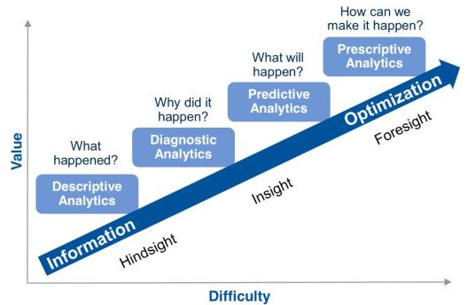
Data Analysis Journey

Slide 7
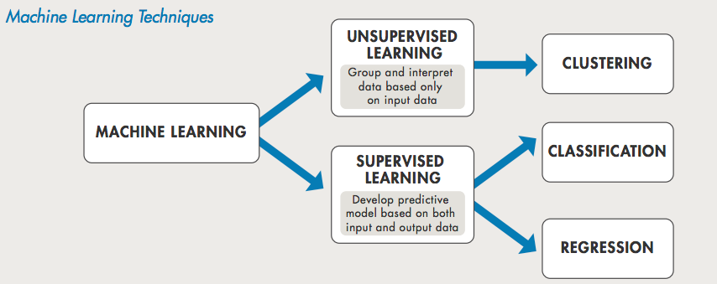
Machine Learning Techniques

Slide 8
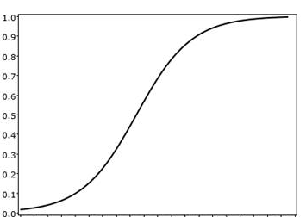
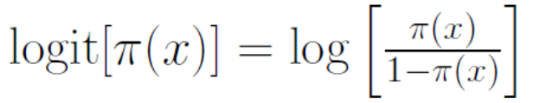
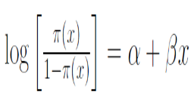
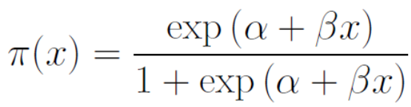
Logistic Regression
  P(‘Success’|X)
  X

Slide 9
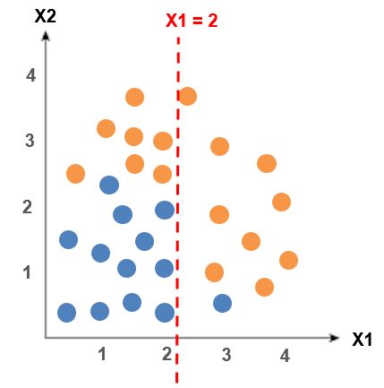
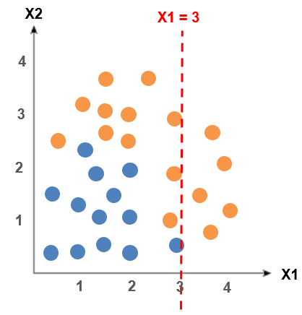

Decision Tree
  16 obs.
  13 obs.
  E = 0.99
  7 obs.
  12 obs.
  9 obs.
  1 obs.
  11 obs.
  13 obs.
  5 obs.
  0 obs.
  E = 0.95
  E = 0.47
  E = 0.99
  E = 0
  IG = 0.21
  IG = 0.17

Slide 10
K-Nearest Neighbor
Session 1

Slide 11
The KNN
Works both for Classification and Regression. But widely used for classification
Non-parametric method.
When to consider?
Less than 20 attributes per instance
Lots of training data
Advantage
Easy to program
Training is fast
Do not lose information
Disadvantage
Sensitive to irrelevant/redundant features. All features contribute to the similarity and thus to the classification

Slide 12
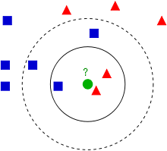
Basic Idea
Store/keep training data
Classify new observation based on similarity to the observation in training data
Chosen class is class of k-observation(s) with the closest distance
Use majority decision rule to classify the records
Training data
Test data (New observation)
Test data will be classified as or ?
(Ignore circle line for now)

Slide 13
Basic Idea
With k=3 nearest neighbors
Test data classified into
With k=5 nearest neighbors
Test data classified into

Slide 14
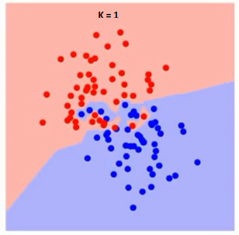
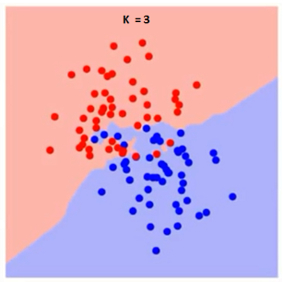
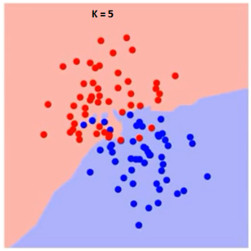
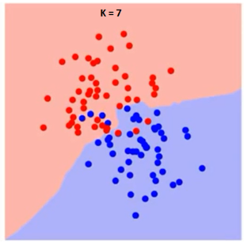
How do we choose factor K?
k=1 k=3 k=5 k=7
Boundary becomes smoother with increase value of K
With K increases to inf, finally becomes all-blue/all-red depending on total majority

Slide 15
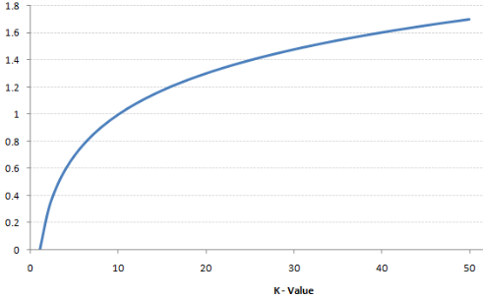
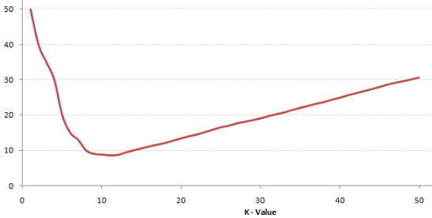
How do we choose factor K?
Training Error Rate
Validation Error
Error rate at K=1 always zero for training sample, closest point to any data point is itself
Overfitting the boundaries at K=1
Error rate decreases with increases K until reach its minima
Tips 1: Use odd number of K
Tips 2: Evaluate using validation or cross validation

Slide 16
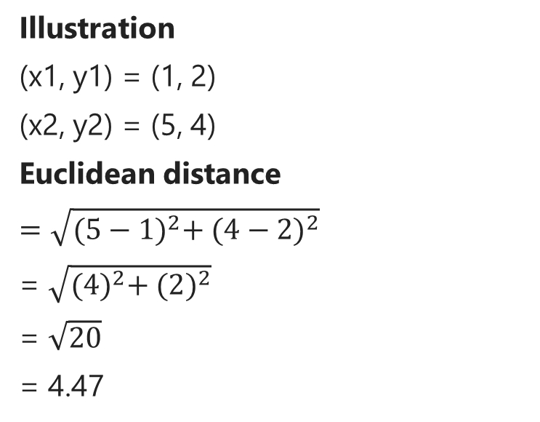
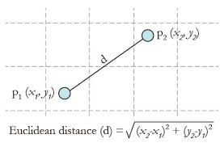
Measuring distance
Closest neighbor is identified based on the distance
There are several method to measure distance. The popular one is Euclidean.

Slide 17
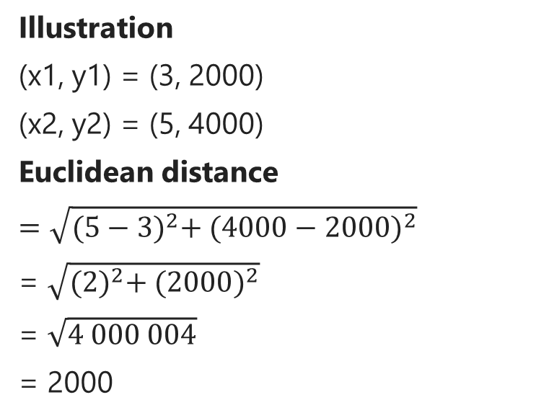
Issue with distance
Given X is Area with unit of hectare
Given Y is Corn Production with unit of kg.
Distance contribution from X is surpassed by contribution from Y due to different scale.
Variable with large scale will have larger effect on the distance.

Slide 18



Issue with distance
Solution to solve scale issue is Normalization.
Min-Max Scaling
Uses MinMaxScaler
Transform to defined range
Standardization
Uses StandardScaler
Transform to mean=0, sd=0
Where
= mean
= Standard deviation

Slide 19
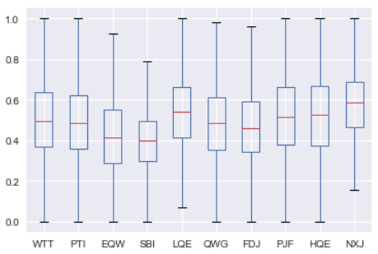
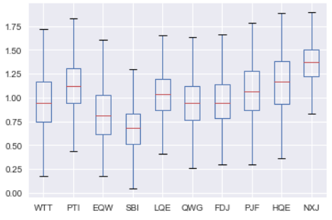
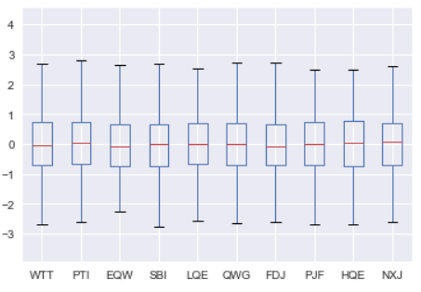
Illustration
MinMaxScaler
Original Data
StandardScaler

Slide 20
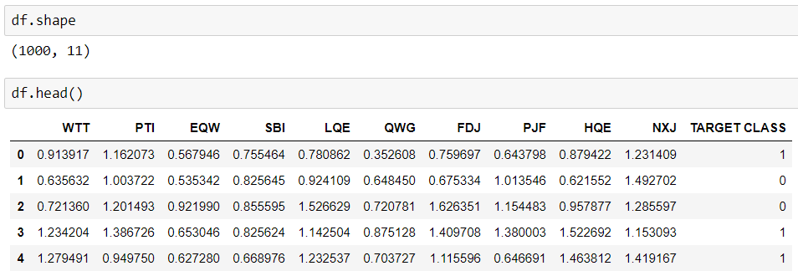
Illustration
Objective: Predict class of new data point using KNN
Data: Provided data from a company, but due to its confidentiality, variable name is masked.

Slide 21
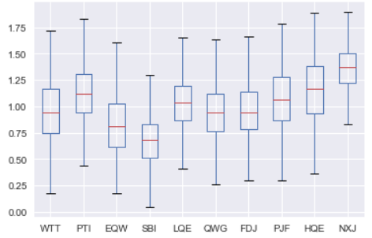
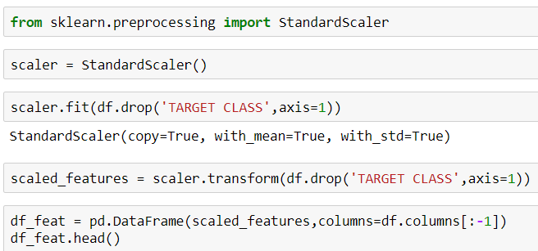
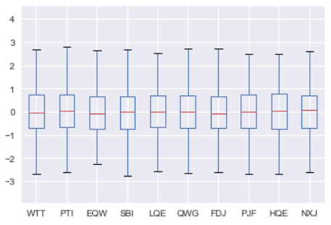
Illustration
Data Preparation: Standardize the variables. In this case using StandardScaler
Before
normalization
After
normalization

Slide 22
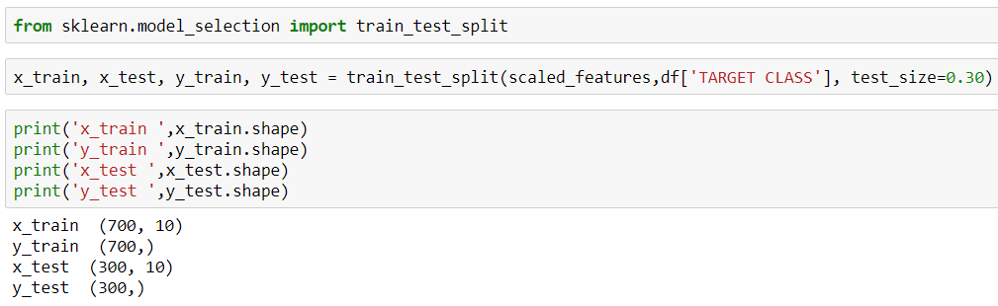
Illustration
Modeling:
Train-Test Split

Slide 23
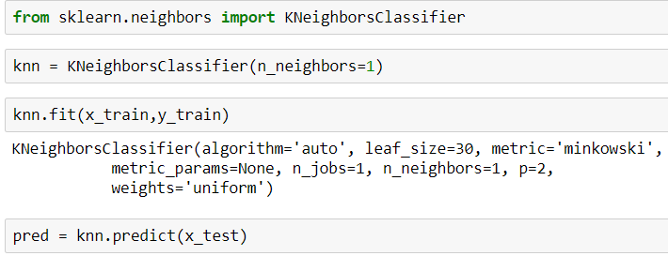
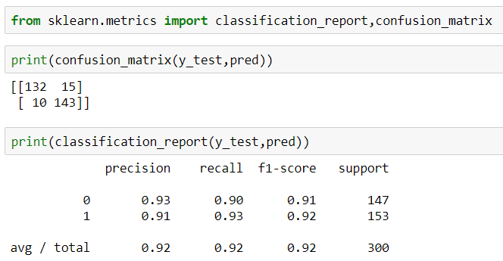
Illustration
Modeling:
Using KNN, start with k=1 Prediction and Evaluation

Slide 24
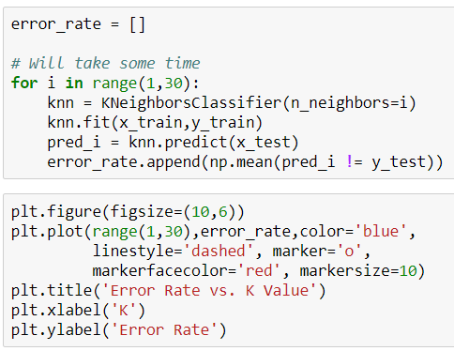
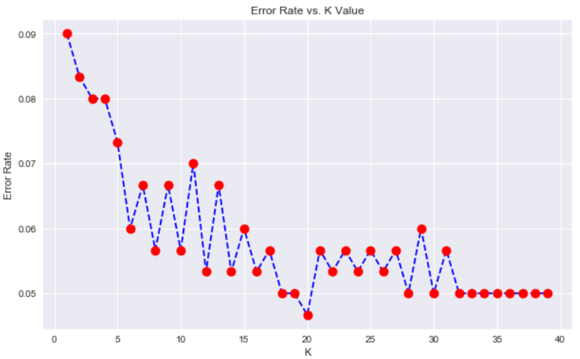
Illustration
Modeling:
Choosing K-Value. Choose K=19?

Slide 25
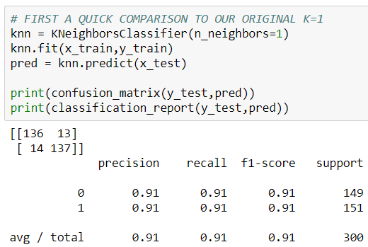
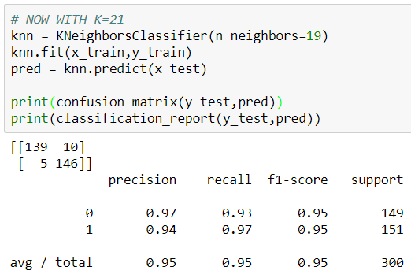
Illustration
Modeling:
Comparison K=1 and K=19

Slide 26
Exercise
Use Case: Predict Default customer
Data: Debtor Dataset
Col Name | Description
NAMA | Debtor Name
T | Event Time
Y | Upselling Status
X1 | Sex
X2 | Age
X3 | Marital status
X4 | # Dependents
X5 | Home ownership
X6 | Education
Col Name | Description
X7 | Area
X8 | Occupation
X9 | Length Of Work
X10 | Income
X11 | Debt Burden Ratio
X12 | Term of Credit (mo)
X13 | Credit Limit
X14 | Credit Quality
class | Classification
Predictor:
X4, X9, X11, X12, X13
Response
Class (1=Not Default, 0=Default)

Slide 27
Ensemble Model
Bagging
Random Forest
Session 2

Slide 28
Ensemble Model Idea
  Combining two or more algorithms (base learners) in order to make more robust system.
  Suppose we want to predict customer default just like we did yesterday. We can use different model such as Logistic Regression, KNN, Decision Tree, etc.
ID | RegLog | DT | KNN | Actual
1 | 1 | 1 | 1 | 1
2 | 1 | 0 | 0 | 1
3 | 1 | 0 | 0 | 0
4 | 0 | 0 | 1 | 0
5 | 1 | 1 | 1 | 1
….
  For example, accuracy are:
  Reglog : 82%
  DT : 79%
  KNN: 70%
  Which algorithm to choose?

Slide 29



Type of Ensemble
  Type of ensemble:
  Averaging
  Majority Vote
  Weighted average

Slide 30
Ensemble Model Idea
  There’s no algorithm that always accurate
  Each algorithm use different Algorithm, Hyperparameter, Training set, Hypothesis
  Imagine a meeting room with experts from different background discussing company stock. Everyone could contribute opinion or suggestion based on their individual point of view. The opinion will be varied.
  Taking account the opinion as input will result more robust final decision, more accurate and less likely to be biased.
  Ensemble model gives the global picture

Slide 31
Challenge
  Challenge in developing ensemble models:
  Not to obtain highly accurate base model, but rather to obtain base model which make different kind of errors
  High accuracy can be accomplished if differential base model misclassify different training examples, even if the base classifier accuracy is low.

Slide 32
Adv-Disadvantage
  Advantages:
  Proven method to improve accuracy of the model
  Model more robust and stable in most scenarios
  For those who love competition, this ingredient wins almost all competition
  Disadvantages:
  Reduce model interpretability
  Time consuming
  Base model to ensemble is hard to master

Slide 33
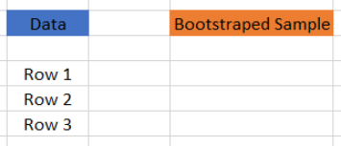
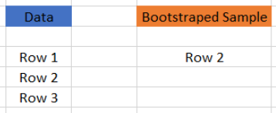
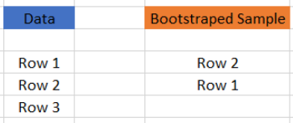
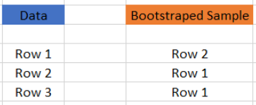
BAGGING
  Bagging : Bootstrap Aggregating
  Bootstrap : Sampling technique in which we choose ‘n’ rows out from ‘n’ rows original dataset with replacement.
  Aggregate individual learners
  Use Voting
  Iteration 1
  Iteration 2
  Iteration 3

Slide 34
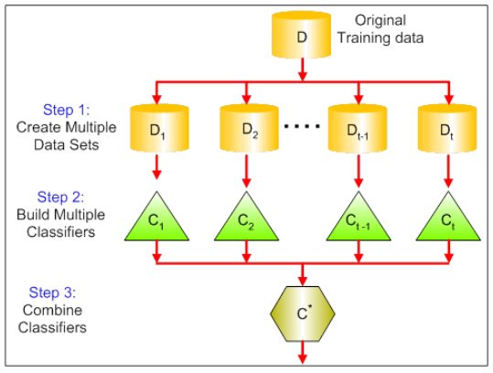
Bootstrap Aggregating

Slide 35
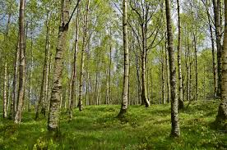
Random Forest
  Just like Bagging, Random Forest use multiple trees.
  Each tree gives classification. We say the tree ‘votes’ for that class
  The forest choose the classification having the most votes over all trees in forest

Slide 36
How RF works
Assume number of cases in the training set is N. Sample of these N cases is taken at random but with replacement. This sample will be the training set.
If there are M input variables, a number m<M is specified such that at each node, m variables are selected at random out of the M. The best split on these m is used to split the node. The value of m is held constant while we grow the forest.
Each tree is grown to the largest extent possible and there is no pruning.
Predict new data by aggregating the predictions of the ntree trees (i.e., majority votes for classification, average for regression)

Slide 37
Adv-Disadvantage
  Advantages:
  Can solve both classification and regression case
  Handle high dimensionality data and results Importance of variable, a handy features
  Has methods of balancing error in data sets where classes are imbalanced
  Data not used for training during bootstrapping is used for testing data, called out-of-bag samples. Error estimated on these data is accurate.
  Disadvantages:
  It works better for classification, but not for regression
  Feel like black-box approach. Very little control to what the software does.

Slide 38
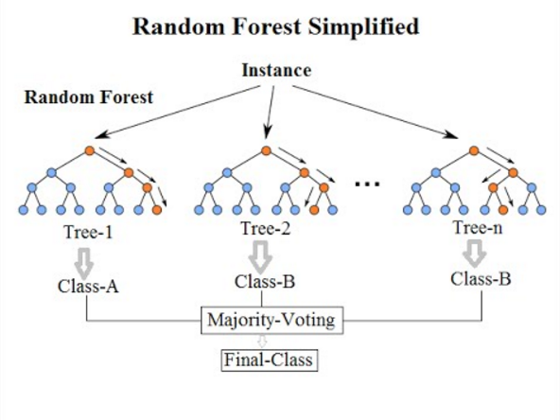
How RF works
https://medium.com/@williamkoehrsen/random-forest-simple-explanation-377895a60d2d

Slide 39

Exercise
Banks play a crucial role in market economies. They decide who can get finance and on what terms and can make or break investment decisions.
Credit scoring algorithms, which make a guess at the probability of default, are the method banks use to determine whether or not a loan should be granted. This competition requires participants to improve on the state of the art in credit scoring, by predicting the probability that somebody will experience financial distress in the next two years.

Slide 40
Exercise
Session 3

Slide 41
Exercise
Challenge
Different to the exercise before, this dataset has imbalanced proportion of response variable.
Proportion of Default / Not-Default = 0.06 / 0.94
Use several algorithm and compare the result.
Compare the model evaluation metrics (Accuracy, Specificity, Sensitivity, etc).
Do you see high accuracy and low sensitivity?
What do you think causes this situation?

Slide 42
It’s a wrap
KNN concept
Distance calculation
Variable normalization
Define best factor K
Ensemble model
Bootstrap concept
Bagging concept
Random Forest concept

Slide 43
IYKRA
Ariobimo Sentral Kuningan, Block 71 Lantai 8.
Jl. HR Rasuna Said Blok X-2, Kav. 6, Kuningan
Jakarta 12950
Thank you

